Slide 1
Introduction to Machine Learning (2a)
Rex W. Douglass
Institute for Political Methodology (IPM) 2018

Slide 2
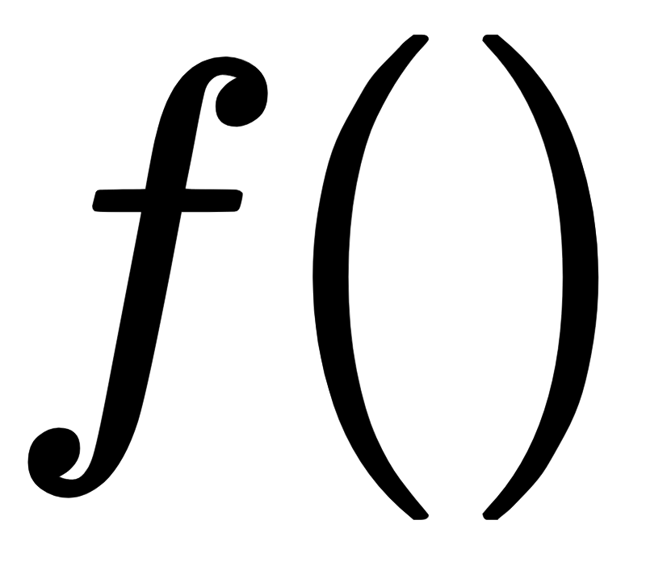
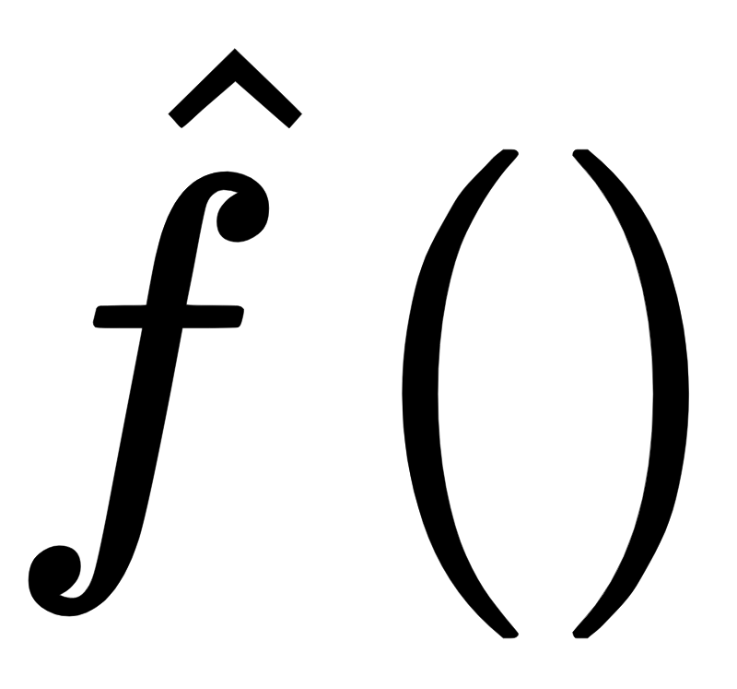
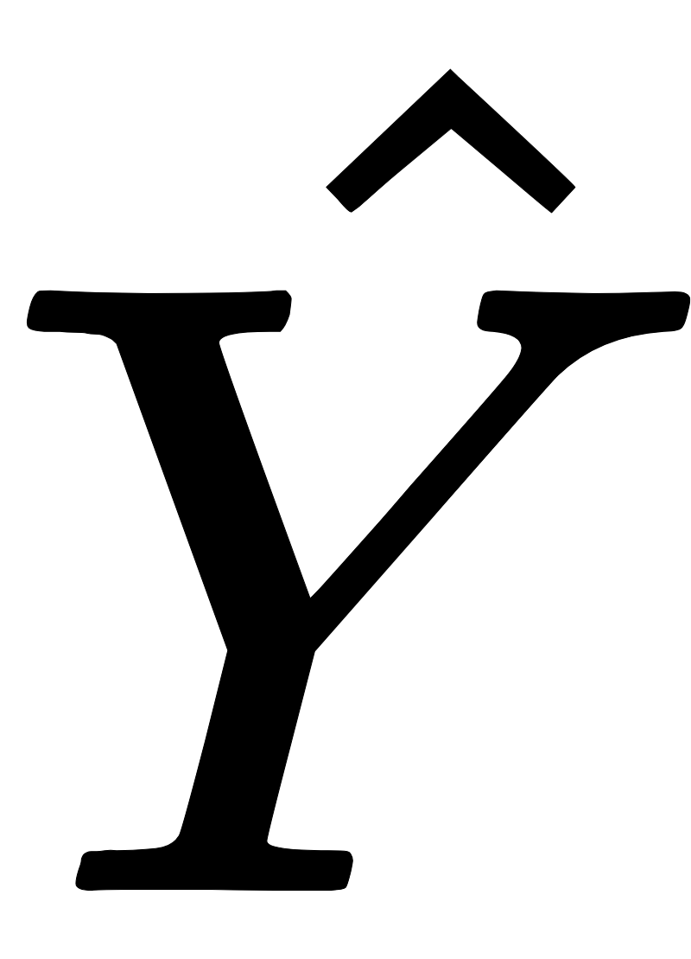
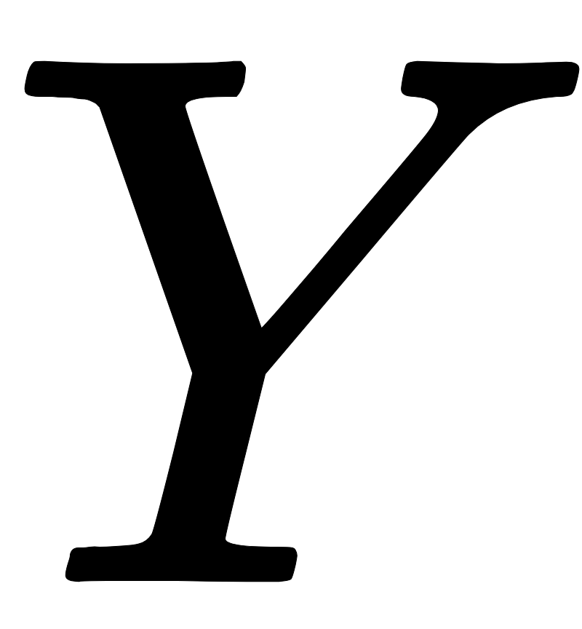
Supervised Learning, Unsupervised Learning, and Engineering
The job is always to build a
that produces accurate
What varies is how many details we get to see beforehand
Do we ever get to examine the true ground state ?
Do we ever get to examine the actual transmitter ?
 |  | Can see
 |  | Yes | No
Can see | Yes | Engineering | Supervised Learning
 | No | Engineering | Unsupervised Learning

Slide 3
Outline
 |  |  | Information Source
 |  | 0-Bits | 1-Bit | 2-Bits | N-Bits
 | 0-Bits | No Conversation | Accuracy Measures
Message | 1-Bits | No Information Conversation Selecting on the Dependent Variable | Risk Analysis/No Free Lunch Overfitting Training/Test/Cross Validation | Underdetermination
 | 2-Bits | Long No Information Conversations | Feature Selection Feature Engineering Model Complexity
 | N-Bits | Very Long No Information Conversations | Confounding Curse of Dimensionality
 |  |  | Mutual Information Accuracy, Precision, Recall,... Area Under the Curve

Slide 4
Outline
 | Linear Models | Decision Trees | Random Forests | Neural Networks
Bias/Variance Trade Off
Feature Selection / Curse of Dimensionality | L1/L2 Penalties Extreme Bounds | Greedy splitting | Split criteria, Subsampling Variables | L1/L2 Penalties / Hierarchical Structure
Feature Engineering | Interaction Terms, Splines | Sequential Splitting | Decision Trees | Dense Layers
Overfitting | Cross-Validation | Pruning | Subsampling Observations | Early Stopping

Slide 5
Nearest Neighbor

Slide 6
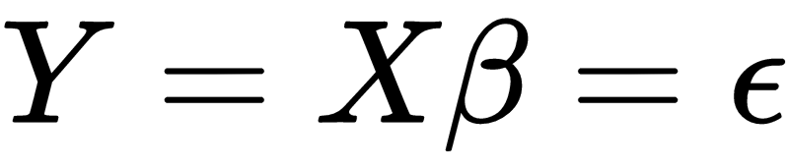
OLS

Slide 8
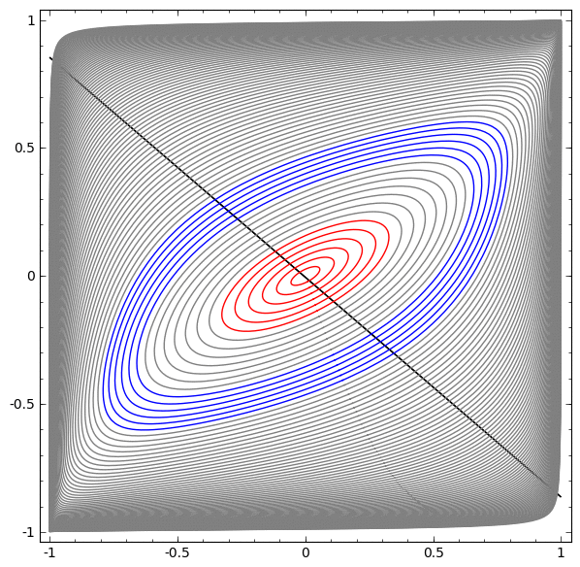
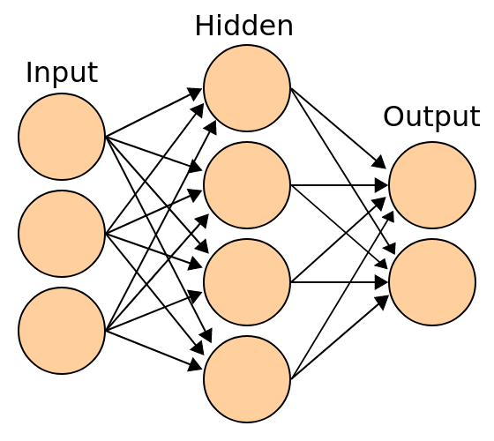
Neural Networks
(Olah 2014)
May require more parameters to define a complicated space
Add an additional ‘layer’ between input and output
Multiple consecutive nonlinear transformations can project original dimensions into a space that is linearly separable

Slide 9
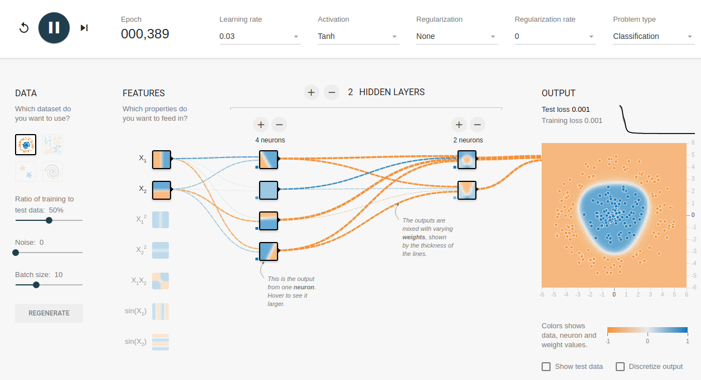
Demo Tensorflow Playground
Tensorflow Playground

Slide 10
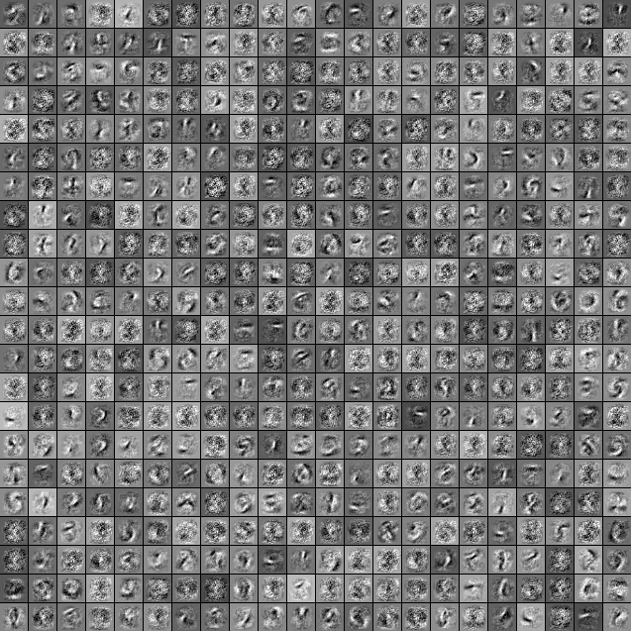
Neural Network Feature Engineering
In image domain, think of features as filters
The human eye has filters that light up when they see vertical or horizontal edges, color contrasts, quick movement, etc.
Neural networks can learn similar filters to reduce the feature space from trillions of combinations to more manageable hundreds to thousands
Here trained a network with 500 neron hidden layer to predict MNIST digits

Slide 11
Variable Importance
Alternative to P values (Lu and Ishwaran 2017)
Procedure
Fit model, calculate out of bag error with cross validation
Pick a variable and shuffle its values
Refit the model with the ‘noised’ version and estimate new error with cross validation
Difference between error with true value and error with ‘noised’ version is importance
Has nice properties
Is in terms of predictive accuracy is which is what we actually care about
Captures both linear and nonlinear contributions to a model
More realistic null to compare to. Not just excluded, but kept in as an orthogonal noise variable

Slide 12
Selective Inference and Forking Paths

Slide 13
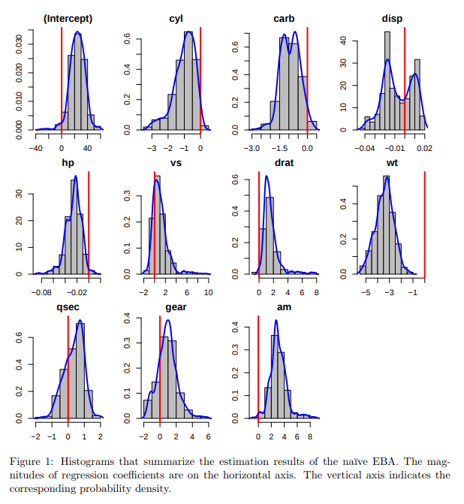
Extreme Bounds Analysis
Big idea: Fit many linear models and examine how parameters vary across specifications

Slide 14
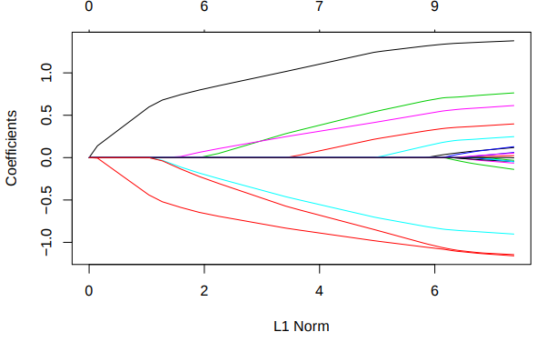
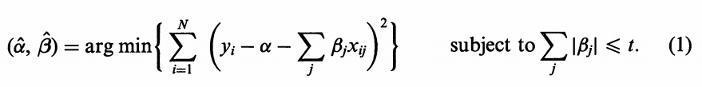
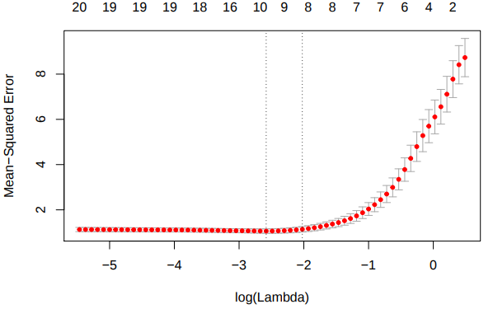
Lasso and Ridge Regression
Big idea -provide a fixed budget for Betas.
Fit a model that minimizes both error and beta ‘used’.
If that budget is the total sum of Betas, it’s called an L1 penalty (Lasso)
Interpret coefficients in context of strength of penalty
Pick a penalty with small out of sample error (cross validation)
(Tibshirani 1996)

Slide 15
Lasso Extensions
Ridge
L2 Penalty penalizes both the size of coefficients and the number of nonzero cofficients
Grouped Lasso
Require inclusion or exclusion of coefficients in groups, e.g. dummies from the same categorical variable

Slide 16
OLS with an outlier and cross validation

Slide 17
Decision Tree
Problem | Answer
Overfitting | Pruning
Feature Engineering | Tree
Many Messages

Slide 18
Decision Tree
Lots of flavors
c5

Slide 19
Decision Tree - Variable Importance
Lots of flavors
c5

Slide 20
Decision Tree - Pruning

Slide 21
Random Forest
Problem | Answer
Overfitting | ⅓ Hold Out Set
Feature Engineering | Decision Tree
Many Messages | Message sampling

Slide 22
Random Forest
Subspace nearest neighbor
Votes are not true probabilities
Low bias and low variance

Slide 23
Feature Importance
Permutation Importance

Slide 24
Neural Network
Problem | Answer
Overfitting | Early Stopping on Validation Set
Feature Engineering | Many to one neurons
Many Messages | Hierarchical structures

Slide 26
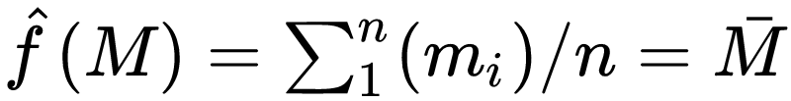
Parametric Functions
What if we didn’t want a fixed rule, but one that could adapt to the data?
How about the mean function?

Slide 27
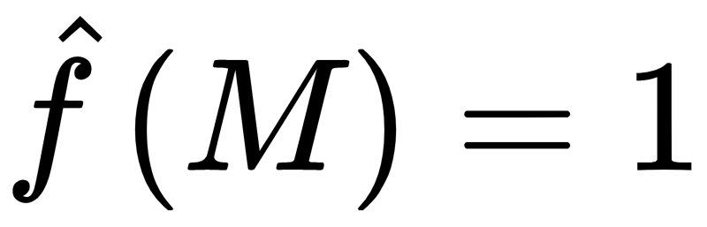
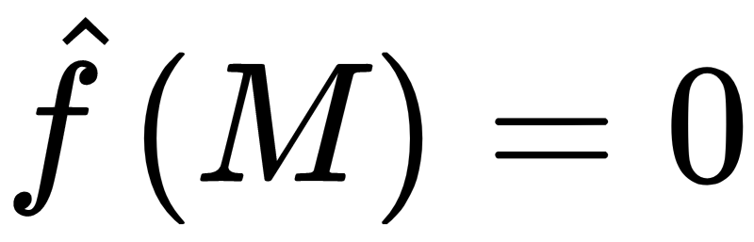
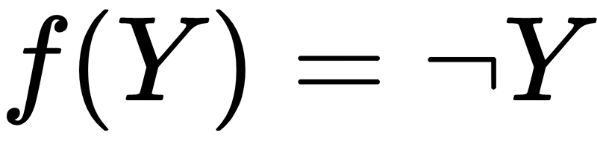
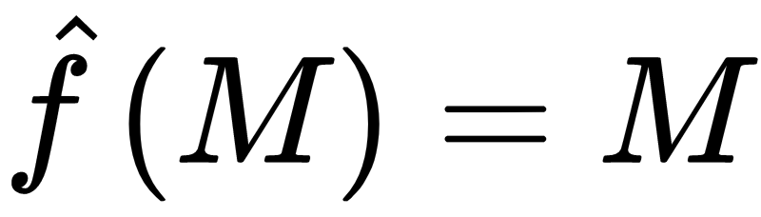
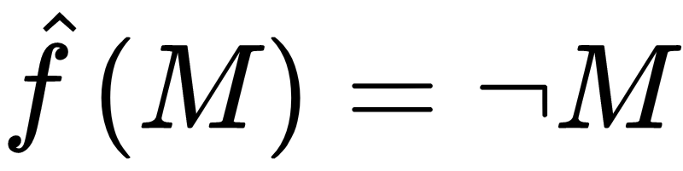
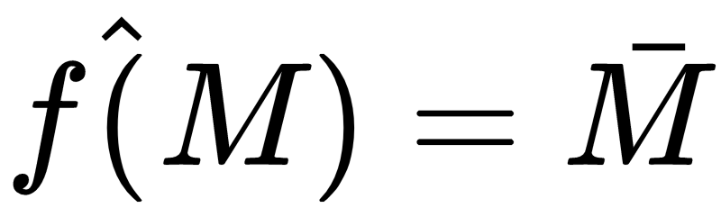
In Sample Accuracy (Mean Function)
= 1,0,1,0,0,0,0,1,0,0
= 1,0,1,0,0,0,0,1,0,0
Y(train) | Transmission Function (Negation) | Receiver Function | In Sample Accuracy
1,0,1,0,0,0,0,1,0,0 |  |  | 0.6
 |  |  | 0.7
 |  |  | 0.0
 |  |  | 1.0
 |  |  | 0.7
Source was fair coin 0.5
Mean of the sequence would be 0.7
Round(0.7)=1
Equivalent to constant 1 function
Accuracy (0.3)

Slide 28
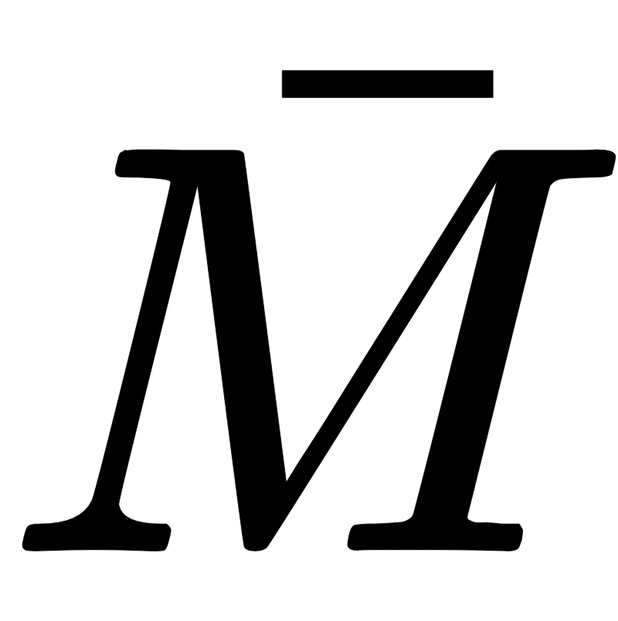
Out of Sample Accuracy (Mean Function)
= 1,0,1,0,0,0,0,1,0,0
Y(train) | Transmission | Receiver Function |  | Accuracy (In)
01011 |  |  |  | 0.6
 |  |  |  | 0.4
 |  |  |  | 0.0
 |  |  |  | 1.0
 |  |  | 0.4- always predict 0 | 0.4
Drawn from fair coin 0.5
Fit on the training data not the test data
Adapts to the training data, but can’t adapt to the test data at prediction time
The parameter is ‘learned’ beforehand
Y(test) | Transmission | Receiver Function |  | Accuracy (Out)
00100 |  |  |  | 0.2
 |  |  |  | 0.8
 |  |  |  | 0.0
 |  |  |  | 1.0
 |  |  | 0.4, always predict 0 | 0.8

Slide 29
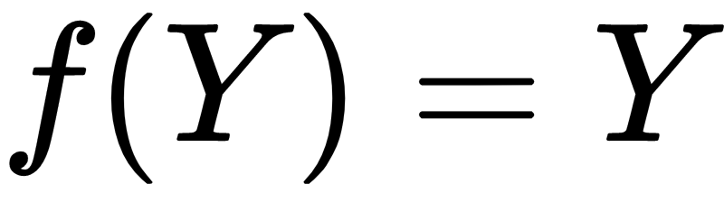
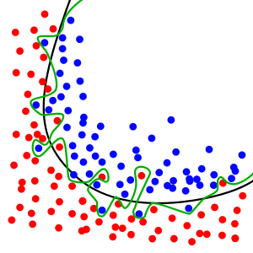
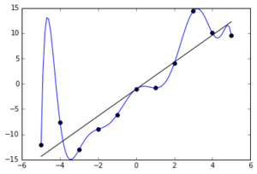
Overfitting
= 1,0,1,0,0,0,0,1,0,0
= 1,0,1,0,0,0,0,1,0,0
Y(train) | Transmission Function (Identity) | Receiver Function |  | In Sample Accuracy
1,0,1,0,0,0,0,1,0,0 |  |  | 0.3 | 0.3
Source was fair coin 0.5
Parameter estimate
was 0.3
Tuned to our specific training set which was just one draw from infinite from a probabilistic source
Would perform poorly on new data which should be closer to 50%/50% as n goes to infinity

Slide 30
Cross Validation
= 1,0,1,0,0,0,0,1,0,0,1,0,1,0,0,0,0,1,0,0
Now N=20
Hold back 20% as test set (4)
Keep 80% as training (16)
Want to know how sampling variation might make test set different from training set
Split training into 4-’folds’ and leave the hold out test set as is
Estimate
= 1,0,1,0,0,0,0,1,0,0,1,0,1,0,0,0
0,1,0,0

Slide 31
Cross Validation
= 1,0,1,0,0,0,0,1,0,0,1,0,1,0,0,0,0,1,0,0
-Drawn from a fair coin
-Out of fold accuracy gives a close guess to accuracy on unseen test data
0.68 vs 0.75
- Is overfit to the training data 0.31 vs true parameter 0.5
Y(train) | Transmission | Receiver Function |  | Accuracy (in-sample) | Accuracy (out of sample)
1,0,1,0,0,0,0,1,0,0,1,0,1,0,0,0 |  |  | 0.31 (0) | 0.69 | 0,1,0,0 0.75
Y(train) | Transmission | Receiver Function |  | Accuracy (in-fold) | Accuracy (Out of fold)
1,0,1,0,0,0,0,1,0,0,1,0 |  |  | 0.33 (0) | 0.66 | 1,0,0,0 0.75
0,0,0,1,0,0,1,0,1,0,0,0 |  |  | 0.25 (0) | 0.75 | 1,0,1,0 0.5
0,0,1,0,1,0,0,0, 1,0,1,0 |  |  | 0.33 (0) | 0.66 | 0,0,0,1 0.75
1,0,0,0, 1,0,1,0,0,0,0,1 |  |  | 0.33 (0) | 0.66 | 0,0,1,0 0.75
 |  |  | Mean Parameter 0.31 (1) | Mean In Fold Accuracy 0.6825 | Mean Out of Fold Accuracy 0.6875

Slide 32
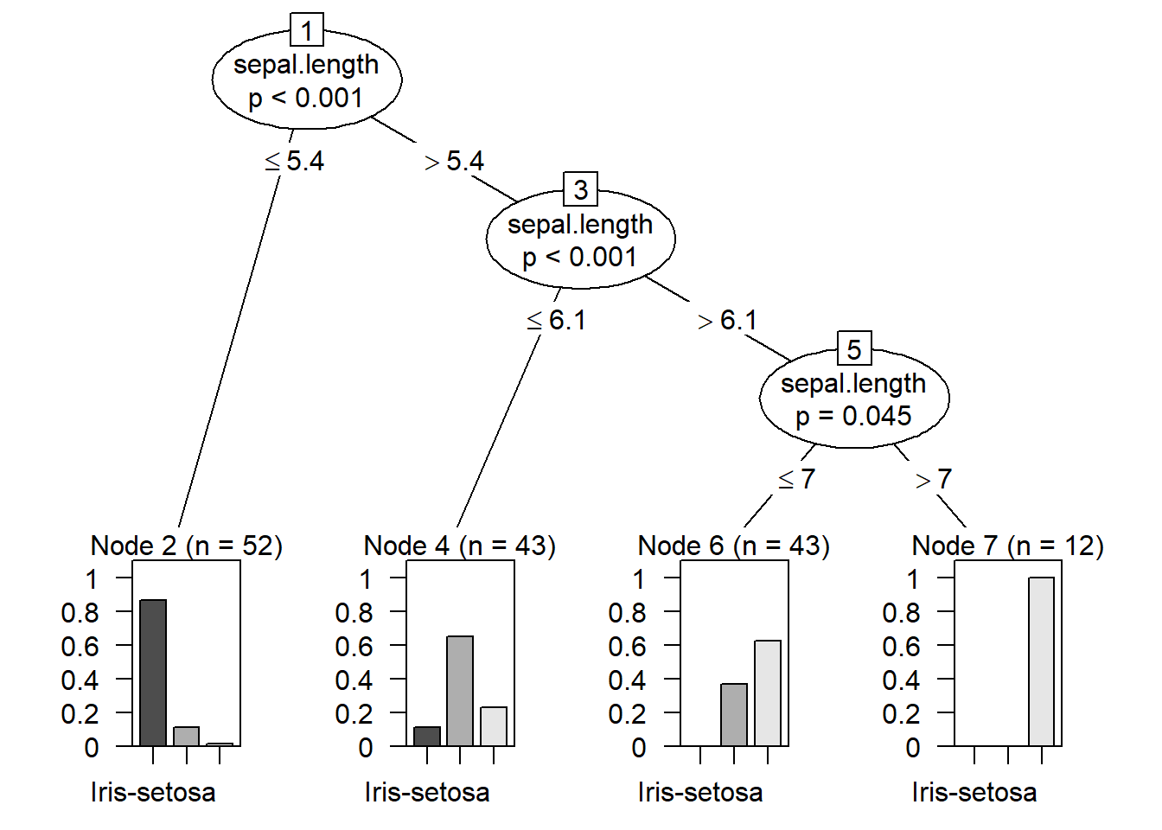
Decision Trees
Big Idea: Partition the data into smaller subsets based on cut points of attributes. Pick the cut points so that the new groups are more similar on the outcome.
Can choose split on the same variable multiple times
Keep splitting until reaching a stopping condition
No more splits can be made (fully grown)
Minimum number of observations in leaf (3 for regression)
Increase in purity below some threshold

Slide 33
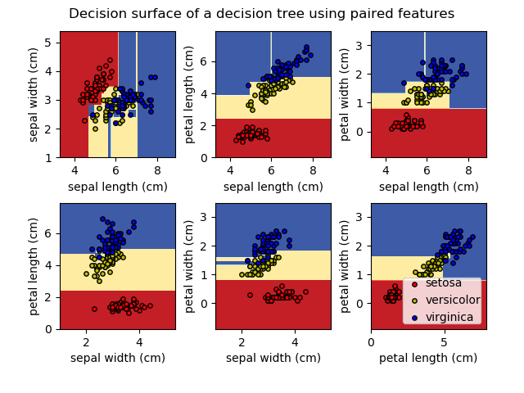
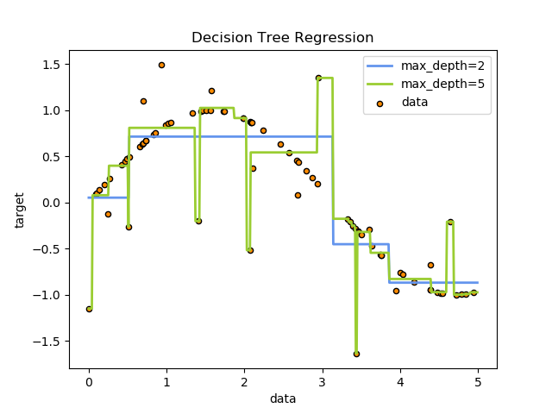
Decision Trees
Gives hard and flat decision boundaries (looks blocky)
Can overfit the data
Able to chase all the way out to an outlier

Slide 34
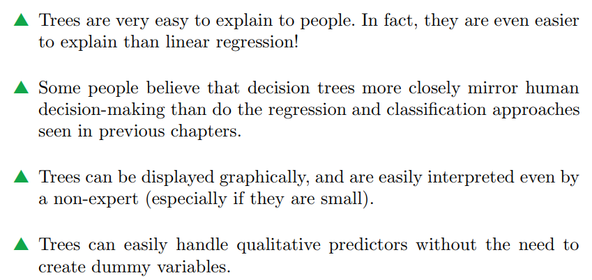
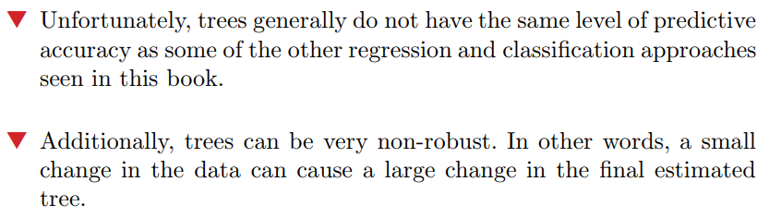
Decision Trees: Takeaways
(Casella et al 2017)

Slide 35
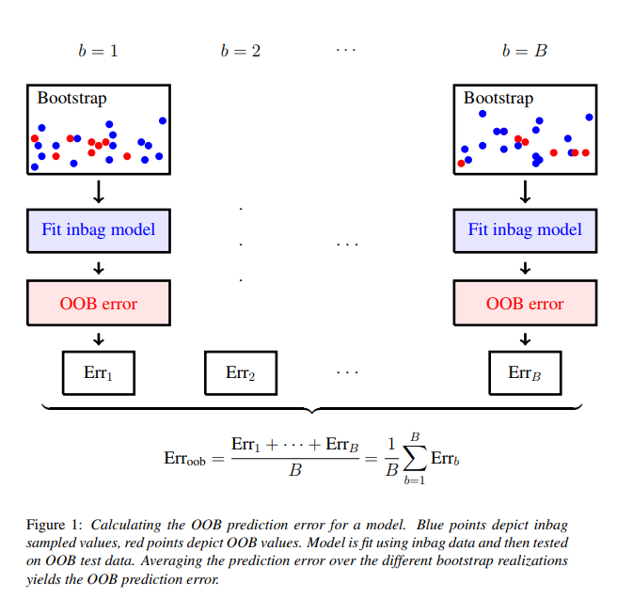
Bootstrapped Out of Bag Error
(Lu and Ishwaran 2017)

Slide 36
Random Forest

Slide 37
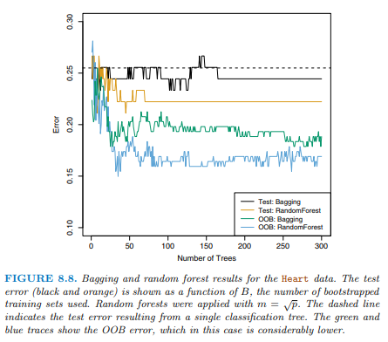
RF: Bootstrapping Observations
By hiding ⅓ of the data from each tree, it can’t learn to overfit the training data
Because no single tree sees the whole dataset and only contribute a vote, you can keep adding them indefinitely and out of bag error will asymptote

